Slide 1


CUSTOMER
MANAGEMENT
SYSTEM
Data Engineering Team

Slide 2

Table Of Content
Creating ERD and Maping
Implementing The Database
Genrating Datasets
Creating the realational Tables
Integrating DWH
Analyzing Data
ML module
Azure could

Slide 3
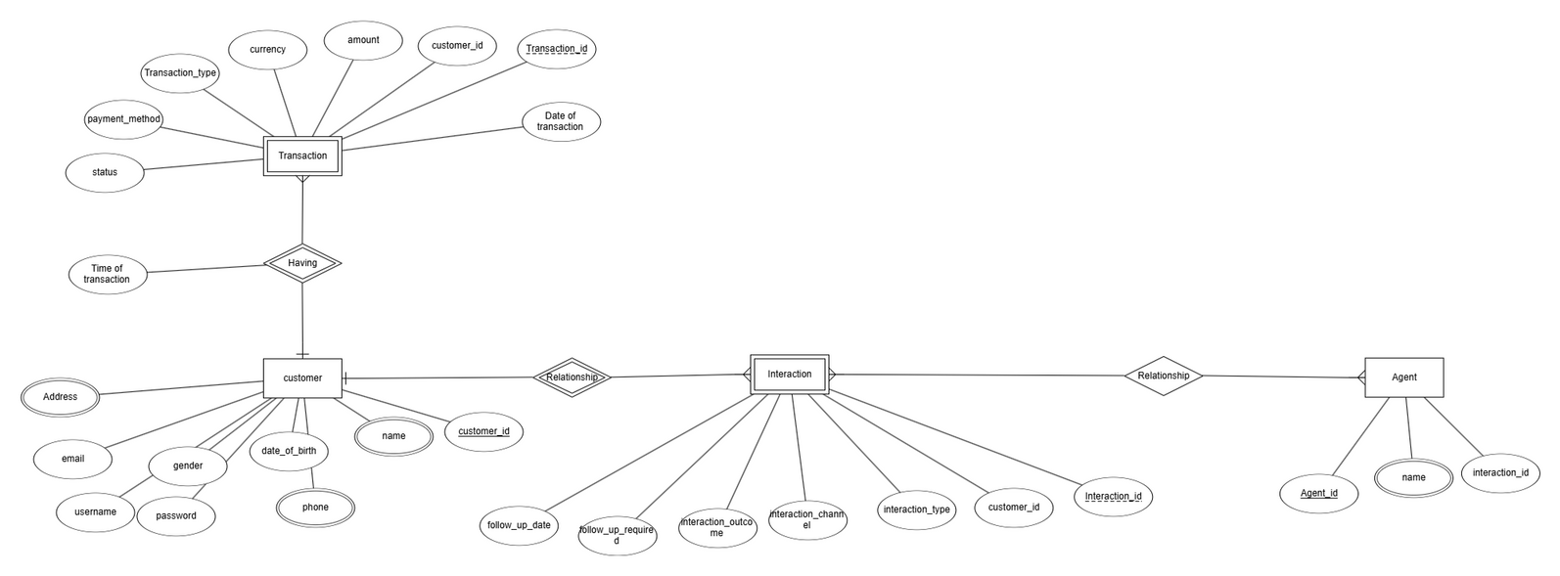
Customer Management ERD
Our project focuses on managing customer data, including their transactions and feedback, which are handled through interactions with agents. We also gather additional data for further analysis.

Slide 4
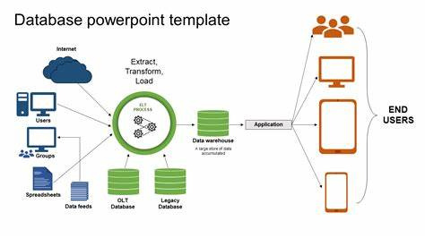
Datasets
& Schema
Dataset
Schema
We Got our Dataset as a genrative dataset from facker lib and random lib which gave us a big database to work on
We applied the ERD and the mapping to the relational database

Slide 5

Problems
As we used generated datasets, we encountered some problems with database integration, such as the compatibility between the integrated data and the stored data in the schema.

Slide 6

Solution
01.
02.
03.
Data convertion
DWH Org
RE integration
we convetion the data to be suitable to our schema
we organized the schema as a DWH and it helped us in Azure pipelining
we Re integrated the Data and mirge it in a new database with a succseful backup to recover data if needed

Slide 7
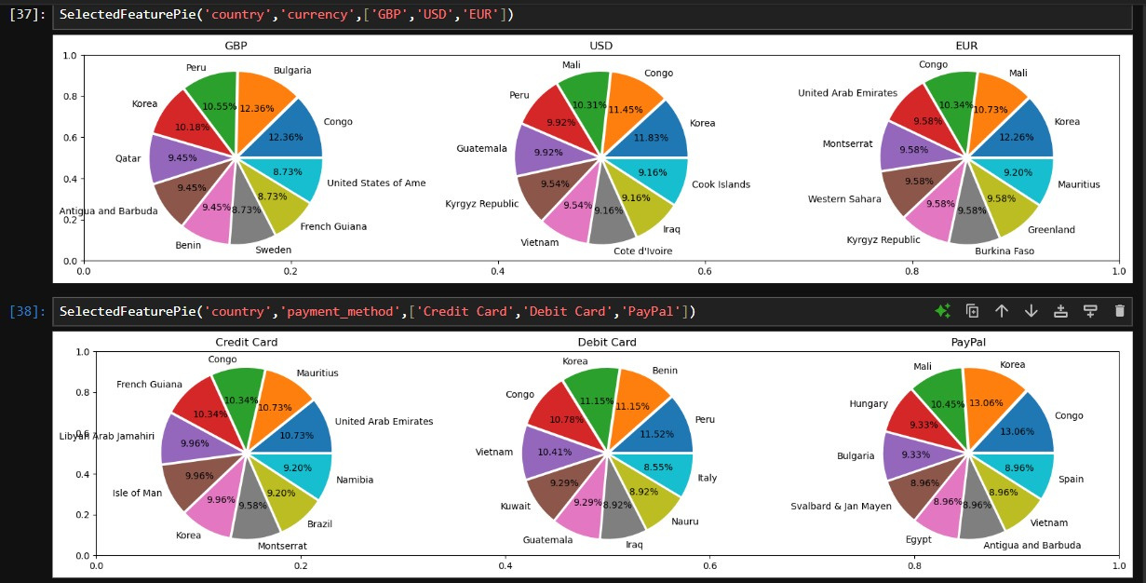
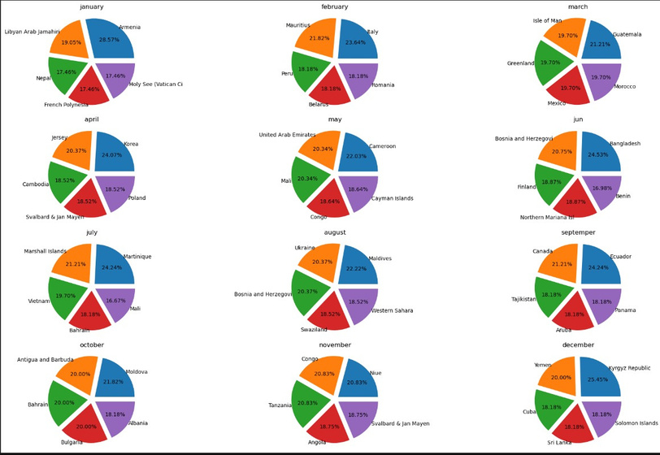
visualization
we analysed and visualized variance parameters with different tools such as ssms , python and Azure
each tool had it’s main object
SSMS(sql):show us the information that we need in select statement
python : charts and translation the code into graphs
Azure: graphing the clouded data in Azure

Slide 8

ML module
15%
we made a ML module to pridect some information about customer and it’s Transaction built in the huge data we genrated
module
results
85%
such as
Customer Churn Prediction: Predict which customers are likely to stop making purchases or leave the service.
(classification )

Slide 9

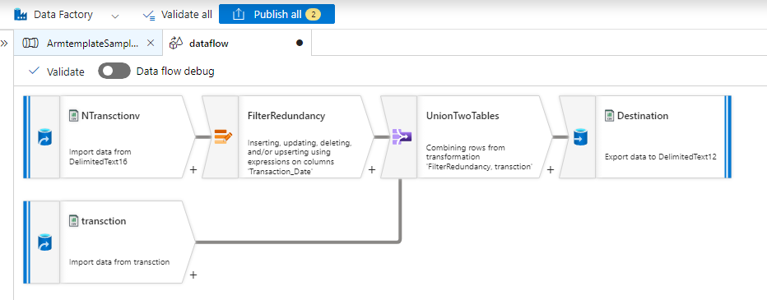
Azure implemntation
Data flow

Slide 10
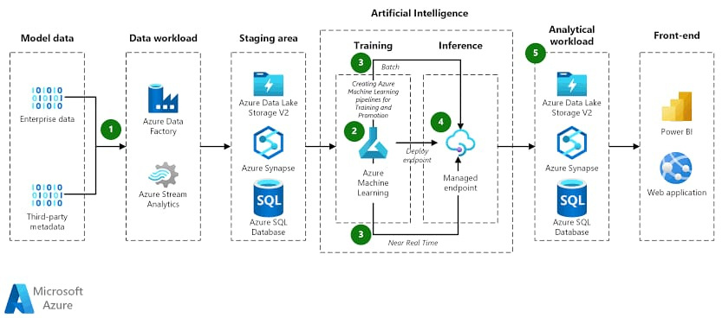
Azure implemntation
Data service setup

Slide 11
ANY QUESTIONS PLEASE

Slide 12
THANK YOU

